Slide 1
ASSINMENT 1
About the 50 startups dataset :
This particular dataset holds data from 50 startups in New York, California, and Florida. The features in this dataset are R&D spending, Administration Spending, Marketing Spending, and location features, while the target variable is: Profit.
1. R&D spending: The amount which startups are spending on Research and development.
2. Administration spending: The amount which startups are spending on the Admin panel.
3. Marketing spending: The amount which startups are spending on marketing strategies.
4. State: To which state that particular startup belongs.
5. Profit: How much profit that particular startup is making.
Challenge: Upload the dataset to Cognos Analytics, explore and visualize the dataset

Slide 2
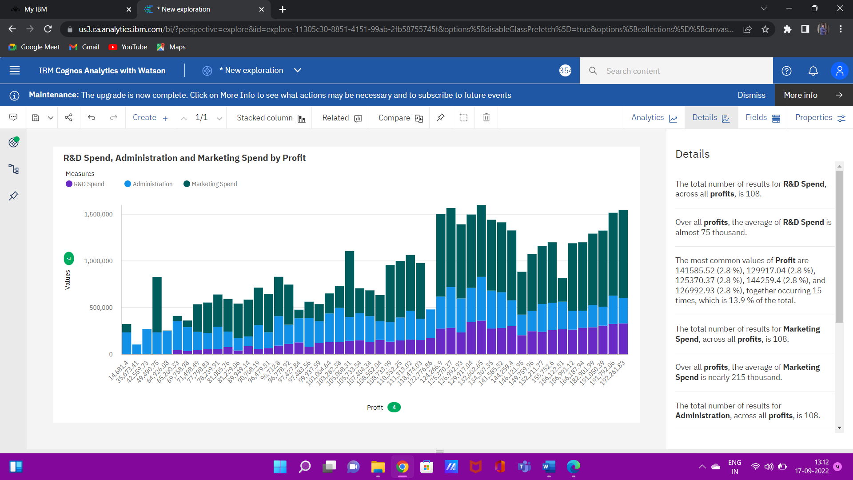

Slide 3
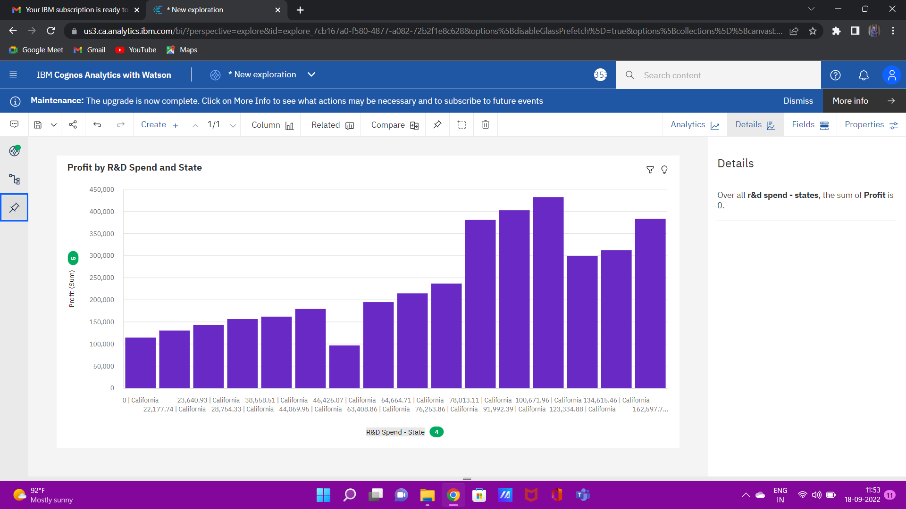

Slide 4
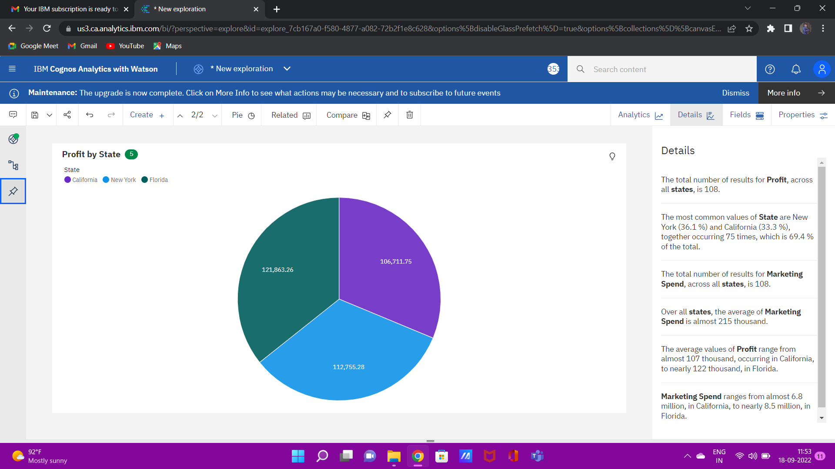

Slide 5
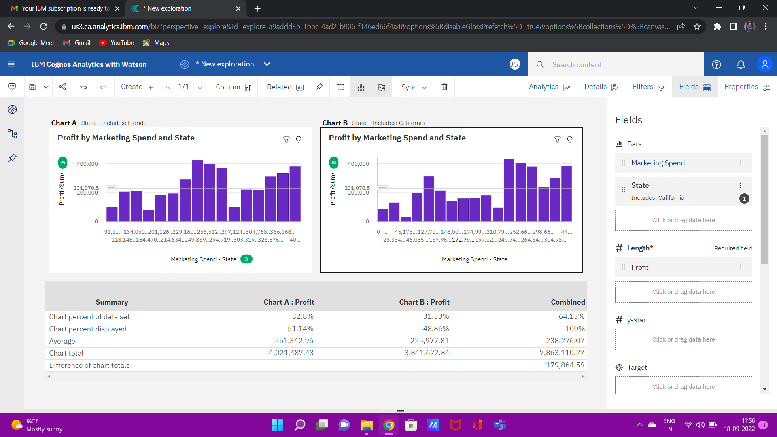

Slide 6
